Slide 1

SWIZO
Food delivery & Donating Website
(Annam Para brahma Swaroopam)
By
2010030055 – Gande Saiteja
2010030272 – Gilla Samanth
2010030236 – Mohammed Adnan
2010030452 – Mohammad Fauzaan Pasha

Slide 2
Introduction
Our project is about an online food ordering & Donating system . It overcomes the disadvantages of the traditional queueing system. It is a medium to order online food hassle free from restaurants as well as mess service and donate food from home. Our mission is to end hunger and no wasting of food to make a hungry-free world. According to the latest survey, 1.3 billion tons of food is thrown as waste every year. Additionally, one-third of the food consumed is stated as leftovers. The focus of this project is to reduce the amount of food wasted and being used to the needy people.

Slide 3
Existing system
The online food ordering system sets up a food menu online and customers can easily place the order. As this online application enables the end users to register to the system online, select the food items of their choice from the menu list, and order food online. Presently people who wish to donate items need to personally visit the organizations and donate foods. In general, the large manufacturers, wholesalers, and organized community This process involves a lot of time to contact the organization to check the requirement. If they do not need the food, then the person has to contact another organization. This makes the donor tired and exhausted. provide food items to food banks or waste tons of foods daily.

Slide 4
Proposed System
The online food ordering system sets up a food menu online and customers can easily place the order and they can even donate their orders or food depending on the customer choice. It enables us to donate the excess food by this website.
The Food Donation module is designed in such a way that .If the user looking to donate food, login using username and password then add the below information in the application:
Name of the food item and the excess quantity.
How many people can be fed with the excess quantity of food.

Slide 5
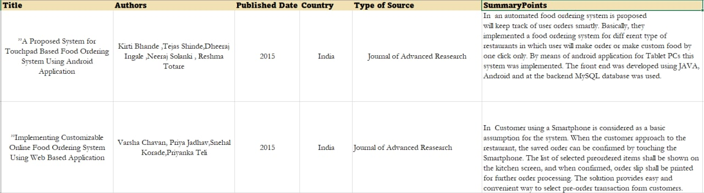
Literature Survey

Slide 6
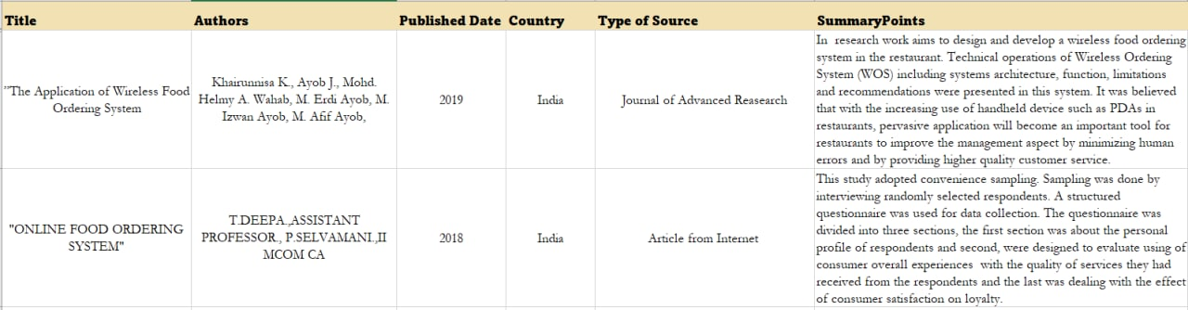
Literature Survey

Slide 7
MODULE
User Module- All the User-related operations can be managed in this module. In this module, a user can register first using their name, contact number, and address and also can manage their profile. The user module will allow users to log in to the system using their names & contact number. And it allows the user to order or donate food.

Slide 8
User Role :
Can log in/log out of the system.
Can manage “My profile”.
Can change password.
Can order food.
Can donate food.
Can share the photos of the donating food.

Slide 9
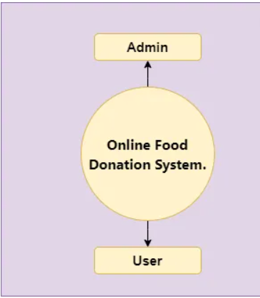
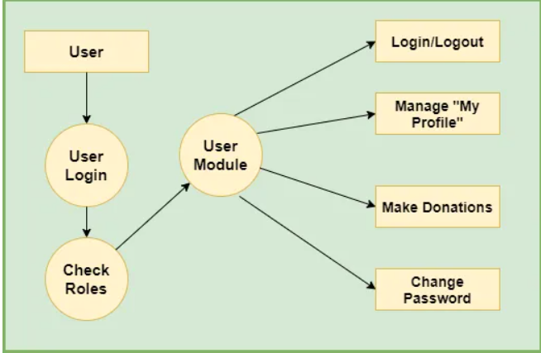
Flow diagrams

Slide 10
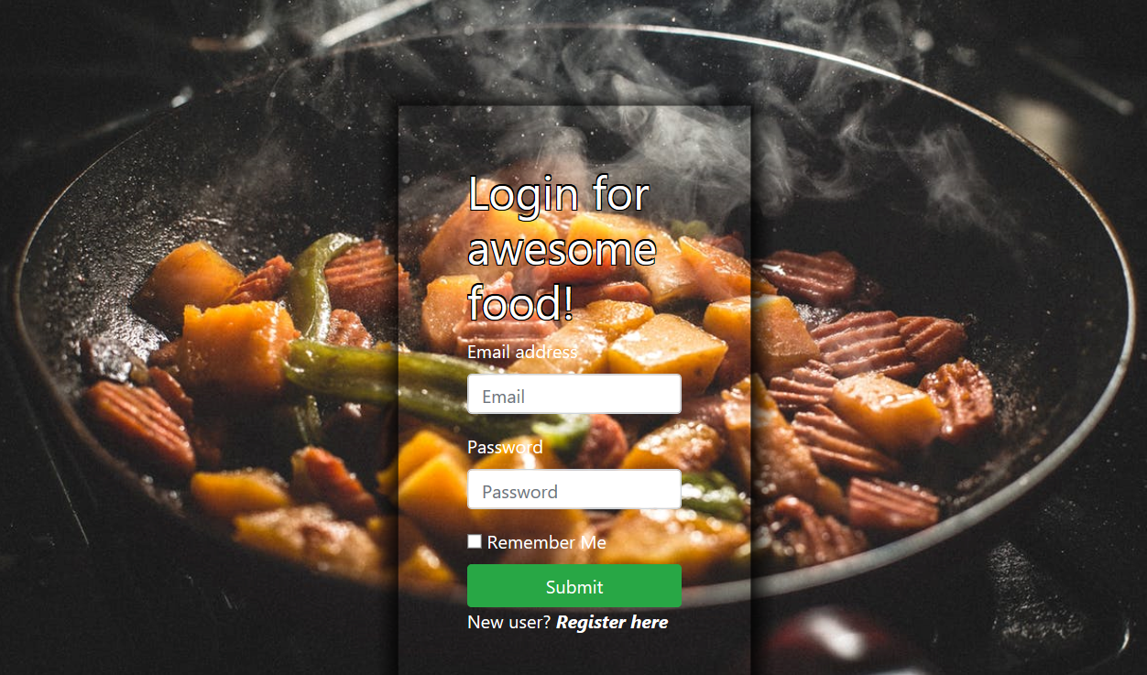
Result

Slide 11
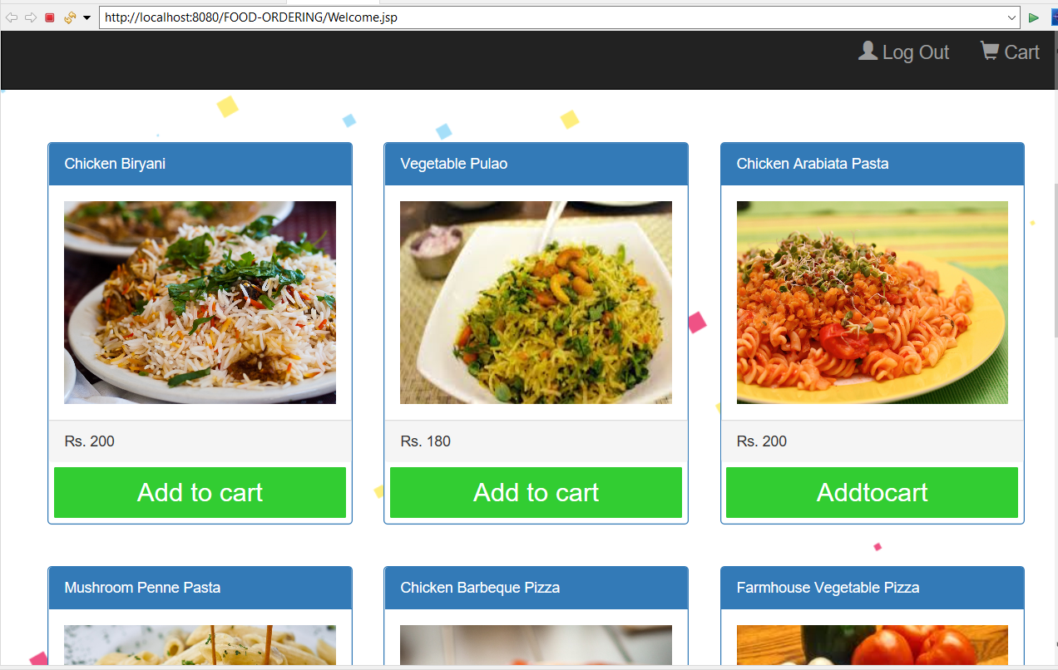

Slide 12
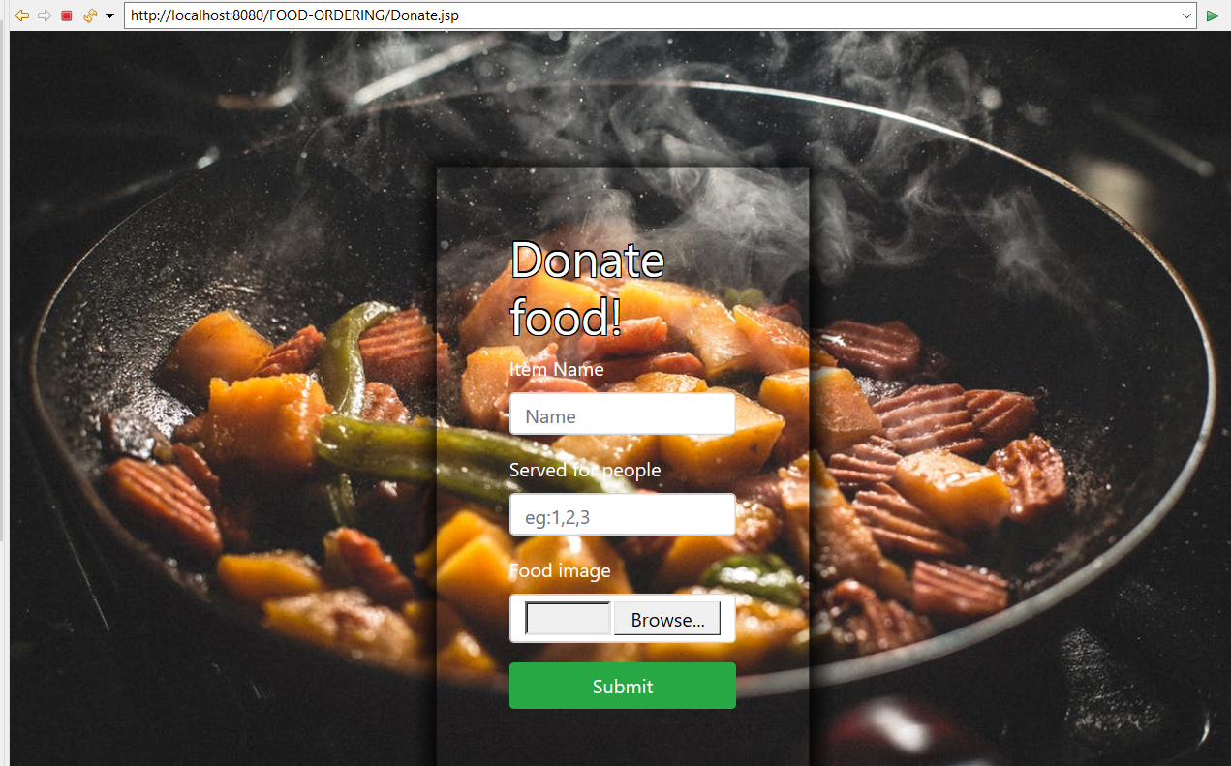

Slide 13
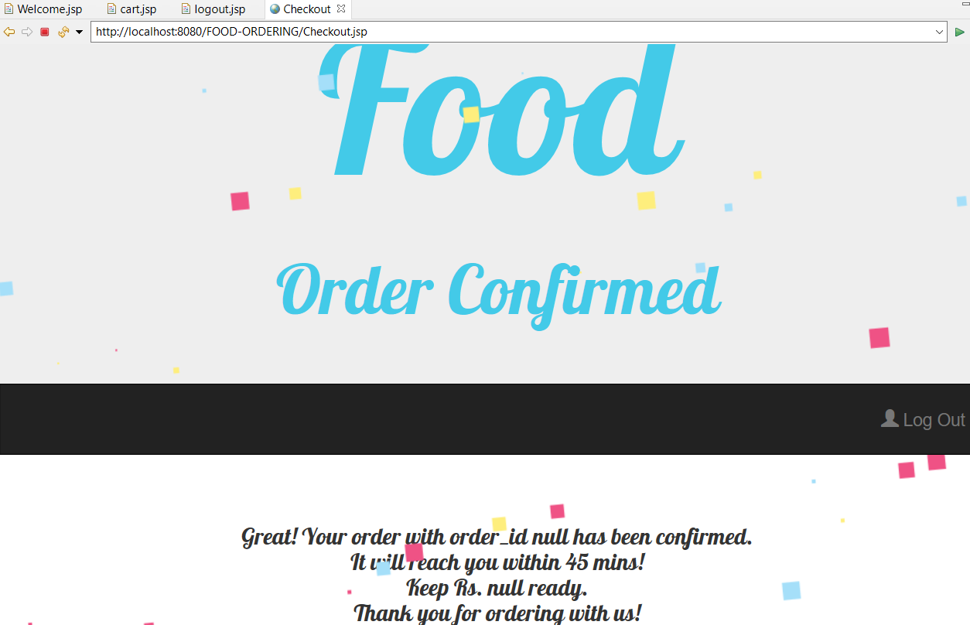

Slide 14
Tools and Technologies Used
Language: Java
Front-End: JSP, Html, CSS, JS, Bootstrap.
Server-side: Servlet.
Back-end: MYSQL.
Server: Tomcat 8.5.

Slide 15
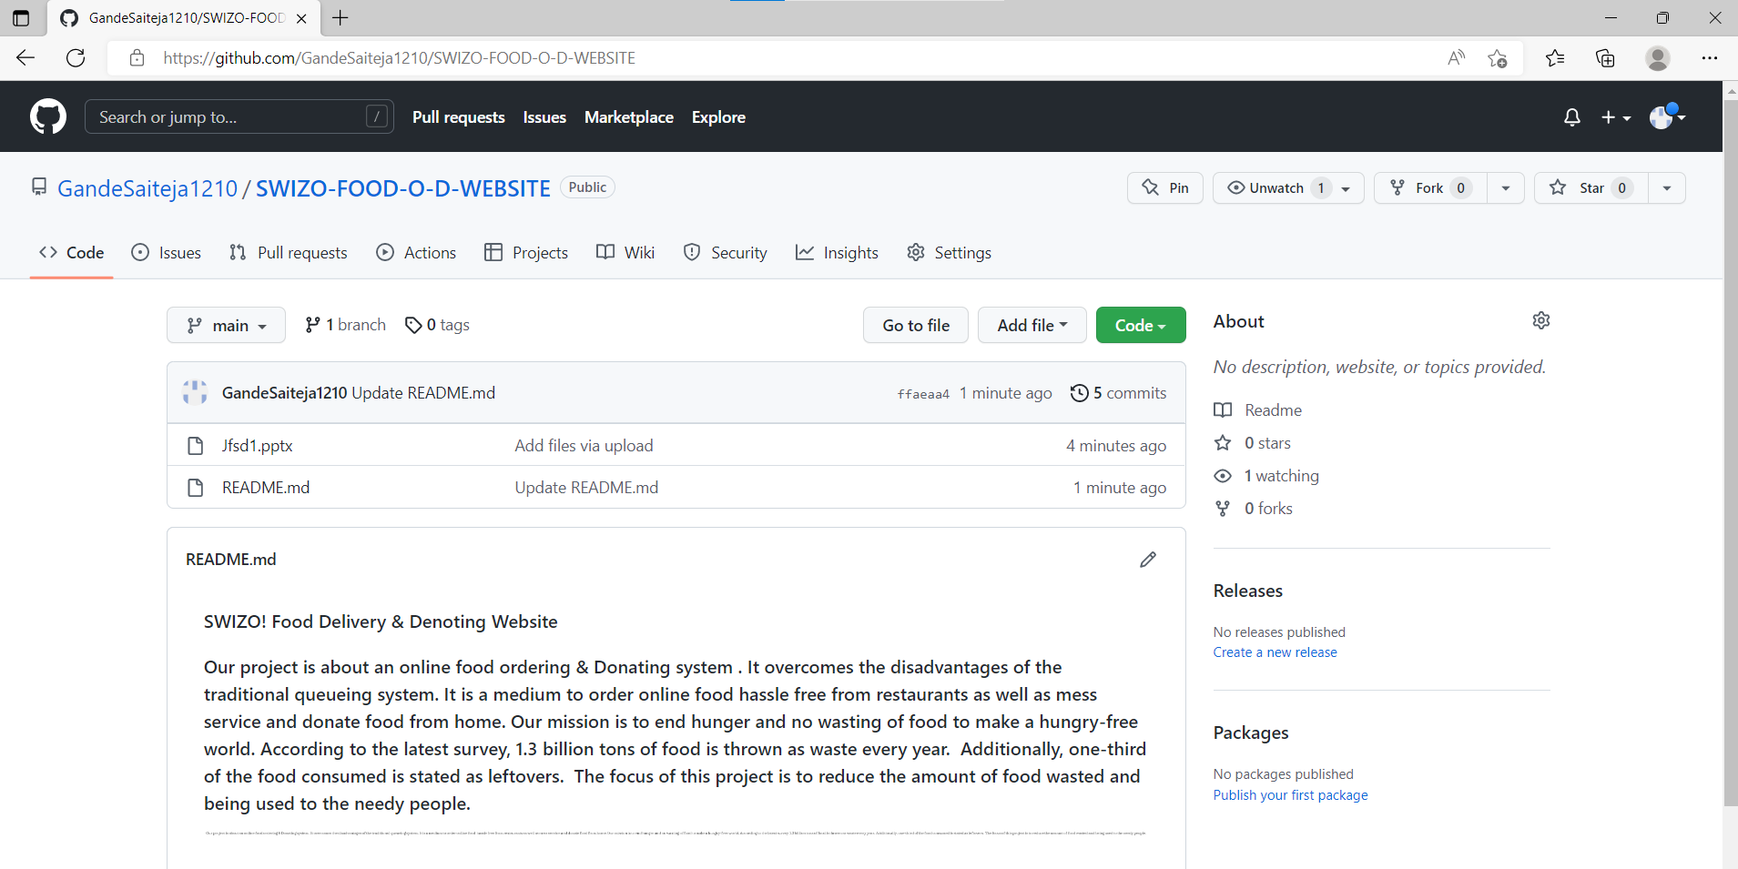
GIT HUB COMMITS

Slide 16
Conclusion
Finally, an online food ordering system is presented that may be used in small family-run eateries This project has the potential to be scaled up in the future. It is designed for restaurants to help them reduce their everyday management and operational tasks while also improving their customers' eating satisfaction. By offering relatively quality services, restaurant operators may also build strong customer connections. The technology also allows the restaurant to see what foods are on sale in real-time and make modifications to their food and beverage inventory depending on orders submitted and orders processed. The visualization impact of the donation can create a positive impact on the users. Minimizing food wastage and feeding the hunger is the main goal of the project.

Slide 17


